Slide 1
COMP 301 Analysis of Algorithms
Sorting in Linear Time

Slide 2

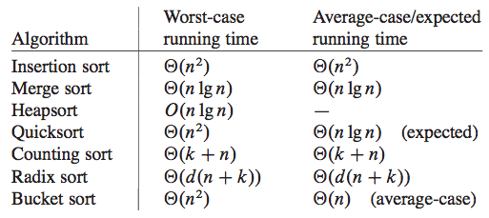
Sorting Problem

Slide 3
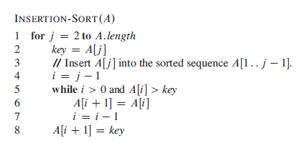
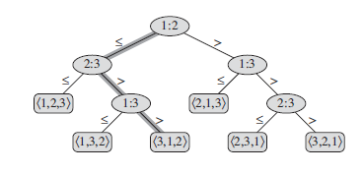
Lower Bounds for Comparison Sort
Comparison sort methods
Insertion sort, merge sort, heap sort, quick sort
Decision tree model

Slide 4
Lower Bounds for Comparison Sort
There are 3! = 6 possible permutations of the input elements, and so the decision tree must have at least 6 leaves

Slide 5


Lower Bound for Worst-Case

Slide 6
Lower Bound for Worst-Case

Slide 7
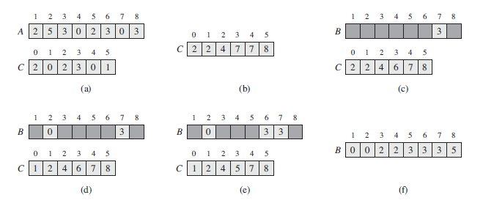
Counting Sort
Assumes that each of the n input elements is an integer in the range 0 to k, for some integer k.

Slide 8
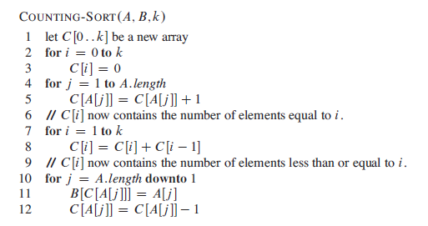
Counting Sort

Slide 9
Counting Sort
Counting sort is stable
numbers with the same value appear in the output array in the same order as they do in the input array.
it breaks ties between two numbers by the rule that whichever number appears first in the input array appears first in the output array.
The property of stability is important only when satellite data are carried around with the element being sorted.
Counting sort is often used as a subroutine in radix sort.
In order for radix sort to work correctly, counting sort must be stable

Slide 10
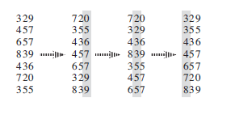
Radix Sort
Used by card sorting machines
Sort n numbers each with d-digits
Start with the least significant digits first

Slide 11

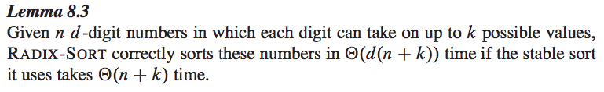
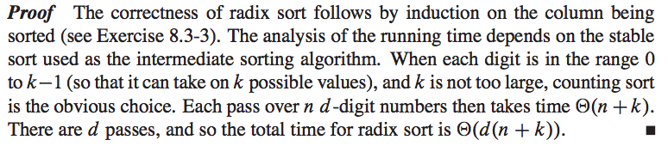
Radix Sort

Slide 12
Radix Sort
When d is constant and k is O(n) radix sort runs in linear time

